Slide 1
A Caveat
When we say Autumn/Fall 2013 : the collections were presented in the Autum/Fall of 2012.
The videos you will see in Zara of Autumn/Fall 2013 was uploaded in August 2013.

Slide 2
Autumn 2013 Fashion : Women

Slide 3



1990s
1990s
Prints

Slide 4

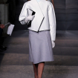

Hats
Outerwear
Plaid

Slide 5



Skirt Suit
Fur
Crazy Combos

Slide 6
Fall Winter Trends 2013 - Men

Slide 7


Slide 8


Slide 9


Slide 10


Slide 11


Slide 12


Slide 13


Slide 14


Slide 15
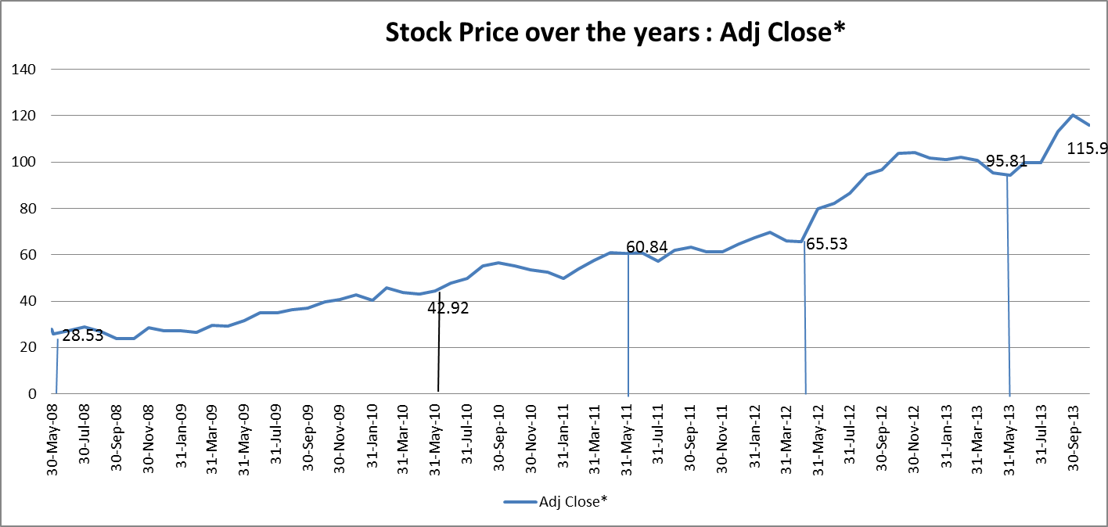

Slide 17

Zara

Slide 18
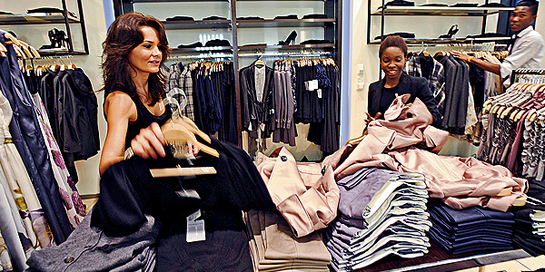
Zara: Fast Fashion from Savvy Systems
A Zara store in Manhattan
Medium quality “fast” fashion clothing at affordable prices.
Notes:
http://www.businessweek.com/magazine/content/08_42/b4104066866245.htm
Controlling the supply chain is key, Jennifer S. Altman

Slide 19
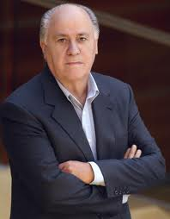
Humble beginning: Amanciao Ortega Gaona
At age of 13, worked as a gofer in a shirt store
FASHIONABLE BUT NOT PRICY In the early 1960s Ortega became the manager of a local clothing shop, where he noticed that only a few wealthy residents could afford to buy the expensive clothes. Thus he started producing similar items at lower prices, purchasing cheaper fabric in Barcelona and cutting out pieces by hand using cardboard patterns. Ortega then sold his items to local shops; he used the profits to start his first factory in 1963 at the age of 27.
In 1972 he founded Confecciones Goa, S.A., the first garment-making factory of Inditex
When a German wholesaler suddenly canceled a big lingerie order in 1975, he thought his fledgling clothing company might go bankrupt. All his capital was tied up in the order. There were no other buyers. In desperation, he opened a shop near his factory in La Coruña, in the far northwest corner of Spain, and sold the goods himself. He called the shop Zara.
Net Worth $31 B as of March 2011 ; The richest person in Spain ; The #2 richest person in Europe ; The #7 richest person in the world
Notes:
Amanciao Ortega Gaona is a very well known industrialist and fashion designer. He is the chairman and co-founder of Inditex Group. In 2001, Inditex Group went public and he possessed over 59% of shares which made him a wealthy man. Forbes has listed him as one of the richest person in the world. Ortega always keeps a low profile and never appears in any interview.
Amancio Ortega gaona was born in Leon, Spain on 28 March, 1936. His mother worked as a maid and father worked on railroad. By the time Ortega turned 13, he started working as a delivery boy for a local shirtmaker in the hub of the Iberian textile industry which is called La Coruna, Galicia. He worked at several stores and learned the changing process of cost and product when material travels from manufacturer to the customer. Very soon he began to focus on providing the products straightly to the customers without any involvement of the middle man.
Amancio Ortega Gaona was better called as Amancio Ortega who never went for higher studies. Into the early days of 1960’s, he continued working in textile line and attained good knowledge. He soon became manager of a clothing store and observed that only rich people could pay to buy good clothing. This made him more firm to make fine clothing available and reachable to every people. Very soon, he began to manufacture his own line of products. He started buying low priced cloth material from Barcelona and cheaper but good quality products to the local shops. In the year 1963, Ortega turned 27 years of age and by this time he established his own firm named Confcciones Goa which was known for selling good quality bathrobes.
Amancio Ortega kept on building his firm. In the year 1975, Ortega started his first retail shop named Zara which was situated across the lane from one of the most famous retail store of La Coruna. Very soon, Zara became a well known name for providing good quality designer range of products at an affordable price. By the year 1989, Ortega successfully opened around one hundred stores of Zara in Spain.
In 1985, he established Inditex which turned out to be one of the biggest textile companies by holding Zara and other small stores. He always focuses on cutting the cost of his products so that it may become reachable for common man. Ortega rarely needed any advertisement for Zara as it already became very successful and renowned name in the textile industry.

Slide 20
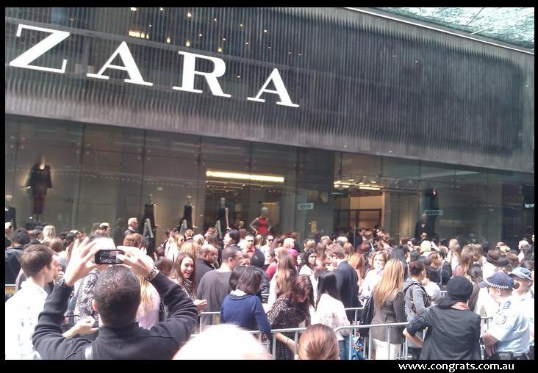
Zara in Australia 2011
Notes:
http://www.congrats.com.au/zara-sydney-opens-to-crazy-lines-zara-australia-20th-april/

Slide 21
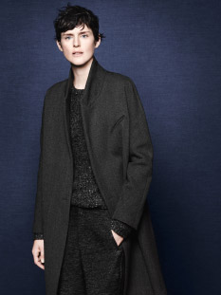
Zara
Zara as a "fashion imitator" company and low cost products.
Trends setter?
Instead of setting the trends, Zara follows them.
Notes:
http://images.businessweek.com/ss/06/08/zara/source/1.htm

Slide 22
Zara’s Positioning
“Armani at moderate prices!”
Fashions are more “Banana Republic,” prices are more “Old Navy.”
Look like high fashion but are comparatively inexpensive.
Cheap Chic
Price
Fashion
Quality
Customer segmentation
Notes:
Chic (pronounced /ˈʃiːk/ "sheek"), meaning 'stylish' or 'smart', is an element of fashion.

Slide 23
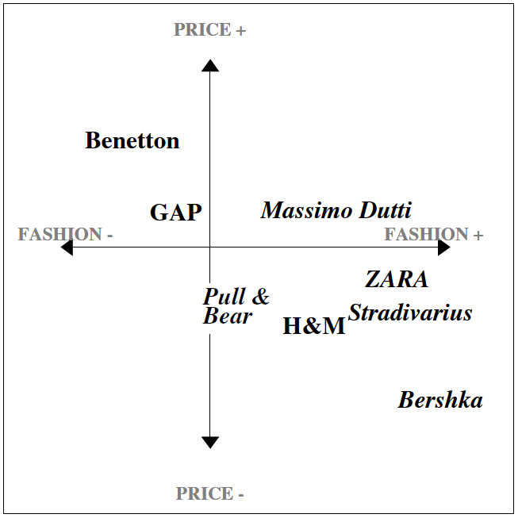
Zara Positioning
The Zara brand is well regarded among the core 25- to-35-year-old consumers

Slide 24
Innovation
"Zara is possibly the most innovative and devastating retailer in the world."
-- Louis Vuitton Fashion Director Daniel Piette

Slide 25
Zara as a Rule Breaker
Zara Thrives by Breaking All the Rules
Contract Manufacturing (Outsourcing, offshore outsourcing)?
factory workers in Spain make an average of $1,650 a month, vs. $206 in China's Guandong Province
34% manufacturing is outsourced to Asia, and 14% to parts of Europe (mainly Italy and Turkey), those tend to be the more basic items. The high-fashion stuff, 49% of what it sells, is cut and finished in “proximity” (Spain, Portugal and Morocco), though some sewing is done by small local cooperatives. [ H&M 75% to Asia][[Check label]]
Marketing? (Budget)
0.3% vs. 3.5% of revenue
Batch Size?
Zara produces in small batches which creates a sense of scarcity with consumers. (Buy now or never)
Fail products% (10% vs. 1%)

Slide 26
Zara as a Rule Breaker
Markdown?
Markdown legend (?)
50% vs. 15%
Frequency of new products arrival & store layout?
Ship twice a week (Z-Day)
Like walking into a new store every two weeks (with store layout changed – directed from the Cube)
Out of stock (Good or Bad)?
Encourages customers to visit often(# of store visit per year 3 vs. 17)
Store product mix decision
Zara retail store managers, not headquarters, determine their own store’s product mix.

Slide 27
Zara as a Rule Breaker
Store Ownership? (Rent vs. Own)
Location of warehouses/distribution centers?
Spain
Get merchandise to European stores within 24H hours, flying goods via commercial airliners to stores in the Americas and Asia in 48H.
Some clothes it has made in China are shipped to Spain and then back to shops in China.
Design Team (Star Designer?)
Rotation (why?)
Cross-functional teams
IN THE PAST THREE SLIDES, WHAT DID WE JUST DISCUSS?
Notes:
http://www.economist.com/node/18333093
The two planes to America each week could supply as many as 40 or 50 stores
https://adrianasassoon.wordpress.com/tag/zara/

Slide 28
A Business Model….
A business model describes the rationale of how an
organization creates, delivers and captures value!
“There’s not a single business model.. There are really a lot of opportunities and a lot of options and we just have to discover all of them.”

Slide 29
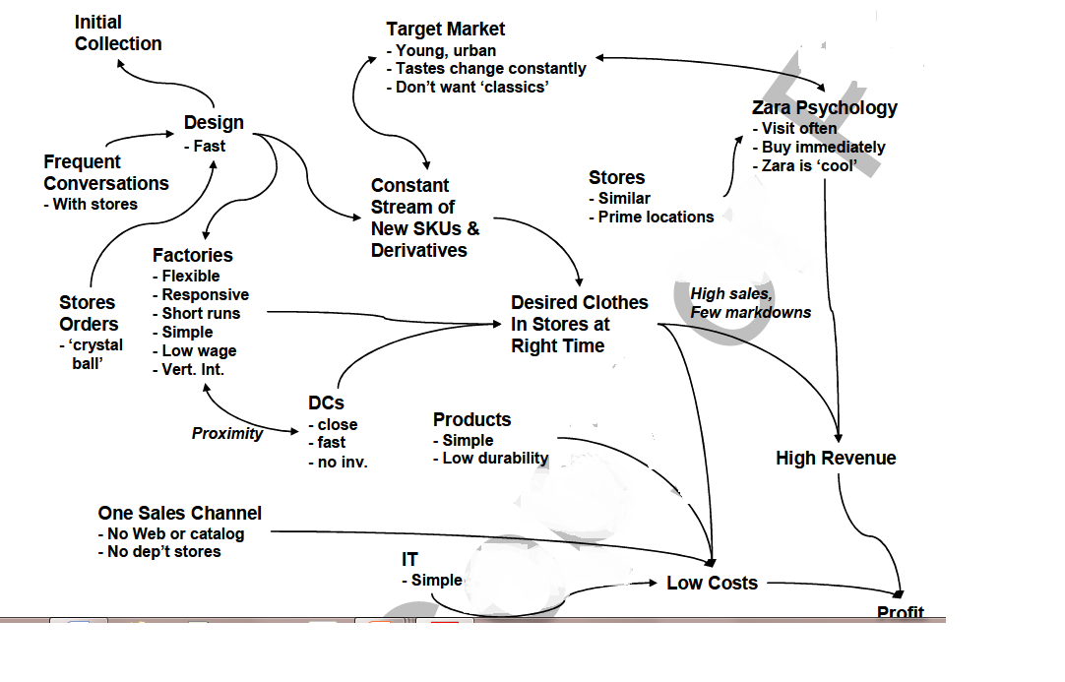
Zara’s Business Model

Slide 30
Some IT Management Principles from Zara
IT is an aid to judgement, not a substitute for it (The system should not make decisions, it just provides the information to help the people make decisions)
Computerization is standardized and targeted (Occam’s Law of IT : As many as you must, as few as you may – they did not make it more complex than what it should be.
Occam’s Law or Occam’s Razor: “Assumptions introduced to explain a thing must not be multiplied beyond necessity, and hence the simplest of several hypothesis is always the best in accounting for unexplained facts”
The simplest solution is the best solution

Slide 31
Some IT Management Principles from Zara
Technology initiatives begin from within. (Before, order forms were faxed, they were replaced by the PDAs were implemented to speed up the process)
The process is the focus (The PDA technology is there to facilitate the ordering process, and thats it.)
Alignment is pervasive (Managers talk like technologists, technologists talk like managers)

Slide 32
UNIQLO

Slide 33
Business Strategy
Developing Products of Exceptionally High Quality
UNIQLO is continuously developing products of exceptional quality, in order to “create clothing with new and unique value and to satisfy customers worldwide.”
Product Development Based on Customer Feedback
Material Procurement from Around the World
Expert Technical Guidance at Factories Emphasizes Quality
http://www.fastretailing.com/eng/group/strategy/tactics.html
While other brands focus on trends, UNIQLO focuses on perfecting the CORE BASIC Clothing
Tagline : Made for all

Slide 34
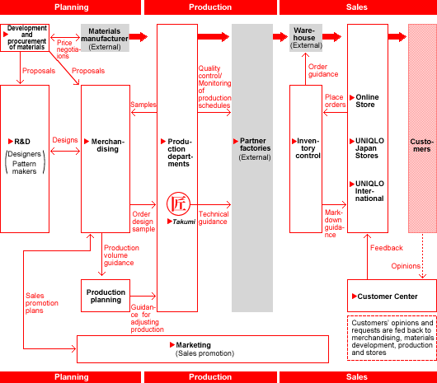

Slide 36
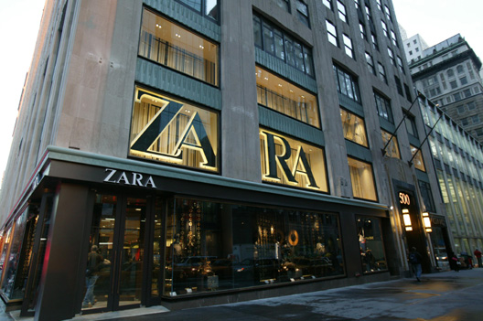
Fifth Avenue Flagship Store
Earlier this year, Inditex spent $324 million on a New York property slated to become its new global Zara flagship store. The purchase of the National Basketball Association's old store on Fifth Ave. is the country's most expensive real-estate transaction, measured in dollars per square foot.
In another recent deal also at 666 Fifth, Japanese clothing retailer Uniqlo agreed to pay $300 million over 15 years, in one of the most expensive leases ever in New York.
Notes:
In another recent deal also at 666 Fifth, Japanese clothing retailer Uniqlo agreed to pay $300 million over 15 years, in one of the most expensive leases ever in New York.

Slide 37
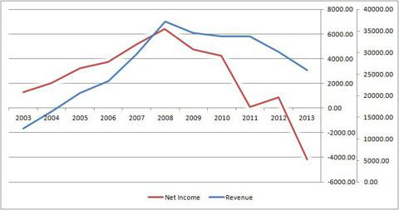
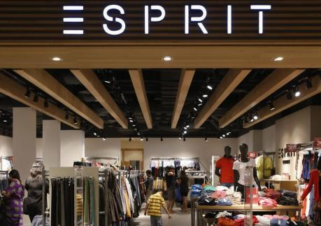
Esprit, the next Zara?
When Esprit last month announced it had hired a senior executive from rival Inditex - the company behind Zara - many took it as a sign the fashion retailer wanted to emulate its successful Spanish competitor as a way of revitalising its own brand.
They are mostly focusing now on improving all of the
products' design and value for money

Slide 38


Differences in the business model?
The "Esprit woman", should be in their 30s and care more about the quality and value of a product than its price.

Slide 39
Differences in the business model?
Esprit now has around half of its sales revenue coming from wholesale, while Zara adopts a vertical business and takes control of the sales of all its products.
Inditex owns most of its stores. Nearly a fifth of Esprit's stores and 60 percent of its sales area is franchised and not directly owned and run by the Hong Kong-listed brand which also has headquarters in Ratingen, Germany. Feedback on which clothes are selling well takes longer. Franchises tend to be quicker to cut their losses by putting poorly selling items on sale - a potential problem for a company such as Esprit, which has franchise-run stores and self-branded stores in some of the same countries.
Most of their stores are in Europe.
Their designs tend to stay in stores in a year → customers wait for discounts

Slide 40
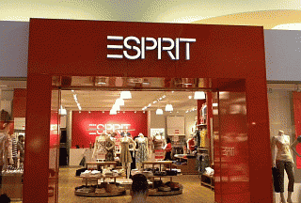
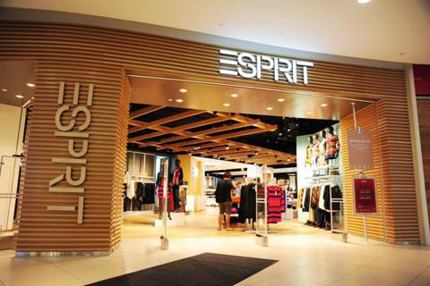
Old and New
Traffic in the FY12 quarter shows that customer visits to refurbished stores was 10% higher than non refurbished stores.

Slide 41
Distribution Center

Slide 42
About Business Models

Slide 43
About Business Models
Business models themselves are complex and not well understood – they lack any formal basis that would facilitate both description and comparison.
Linder and Cantrell assert that:
“executives can't even articulate their business models. Everyone talks about business models but 99 percent have no clear framework for describing their model.”
Minimal description
The business model articulates how the business makes money
Linder, J.C., Cantrell, S. (2000): "Changing business models: surveying the landscape", White Paper, Institute for Strategic Change, Accenture

Slide 44
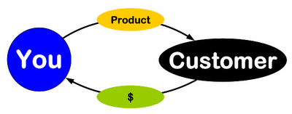
BUSINESS MODEL
How do we deliver value
at an appropriate cost?
What do they value?
Who?
How do we make money?
These are stories that explain how enterprises work

Slide 45
Value Exchange
Service Consumer
Service Provider
Value of
Service
Cost of
Resources
> Price >
Notes:
SJT: Might mention something about the privacy of value to the customer and the privacy of the cost of resources to the provider.

Slide 46
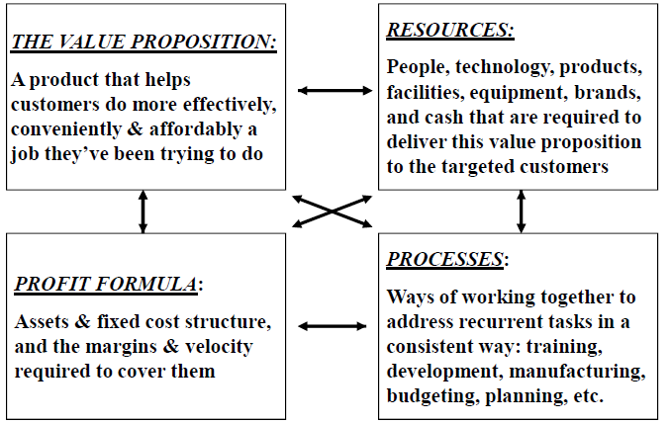
The Components

Slide 47
Interesting observations
The most common format for the business model is a single page of narrative text
A business model does not explicitly include implementation technologies
it is driven by business requirements and simply enabled by technology
Articulation of a business model is no guarantee of its success
only implementation will tell if the model works or not
New business models are increasingly viewed as key intellectual property, and often attempts are made to protect them by patent
Notes:
I think the text page issue is just to get across to people how informal the description is

Slide 48
Extended definition (Perspective 1)
Chesborough and Rosenbloom specify that the 6 functions of a business model are to:
Articulate the value proposition
Identify a market segment, i.e. the users to whom the offering is useful and for what purpose, and specify the revenue generation mechanism for the firm.
Define the structure of the value chain within the firm to create and distribute the offering and determine the complementary assets needed to support the firm’s assets in this chain.
Examine the cost structure and profit potential of producing the offering given the value proposition and value chain structure chosen.
Describe the position of the firm within the value network linking suppliers and customers including identification of potential complementors and competitors.
Formulate the competitive strategy by which the innovating firm will gain and hold advantage over rivals.
Chesborough, Henry; Rosenbloom, Richard: The role of the business model in capturing value from innovation: evidence from Xerox Corporation’s technology spin-off companies, Industrial and Corporate Change, Volume 11, Number 3 pp529-555.

Slide 49
Extended definition (Perspective 2)
Magretta identifies 2 key areas in a business model description
The story
The numbers
Both have to make sense
When business models don't work, it's because they fail either the narrative test (the story doesn't make sense) or the numbers test (the P&L [profit and loss] doesn't add up).
Magretta, J: Why Business Models Matter, Harvard Business Review 2002, Vol 80; Part 5, ISSN 0017-8012, pages 86-93.
Notes:
I could say something about the incomplete numbers story used in a lot of proposed Grid business models due to hidden support

Slide 50
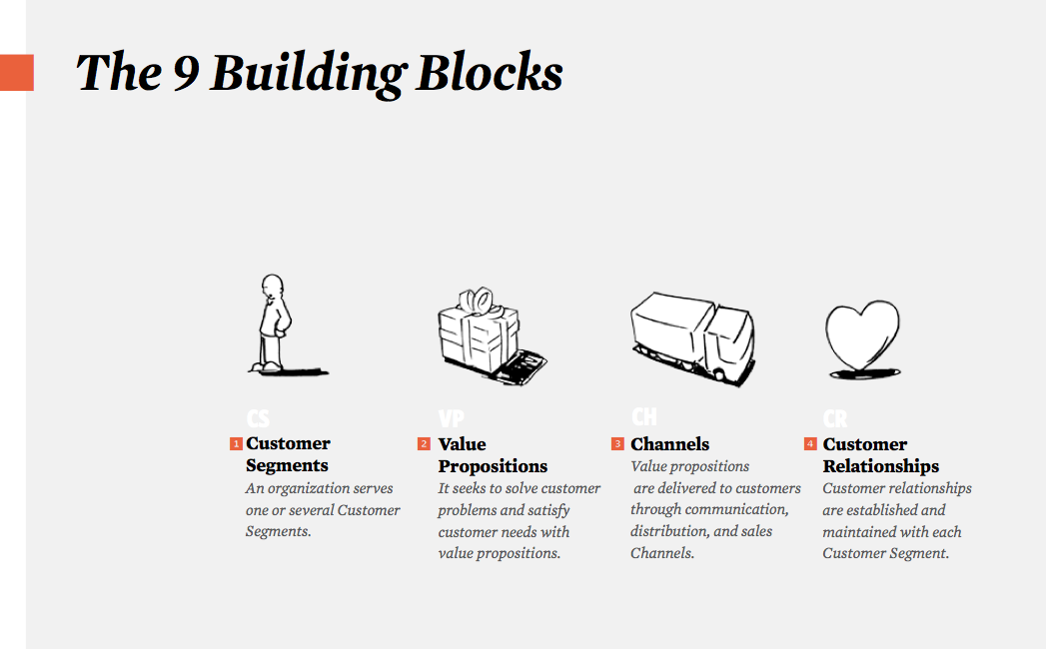
Business Model Canvas (Perspective 3) : Developed by Alex Osterwalder

Slide 51
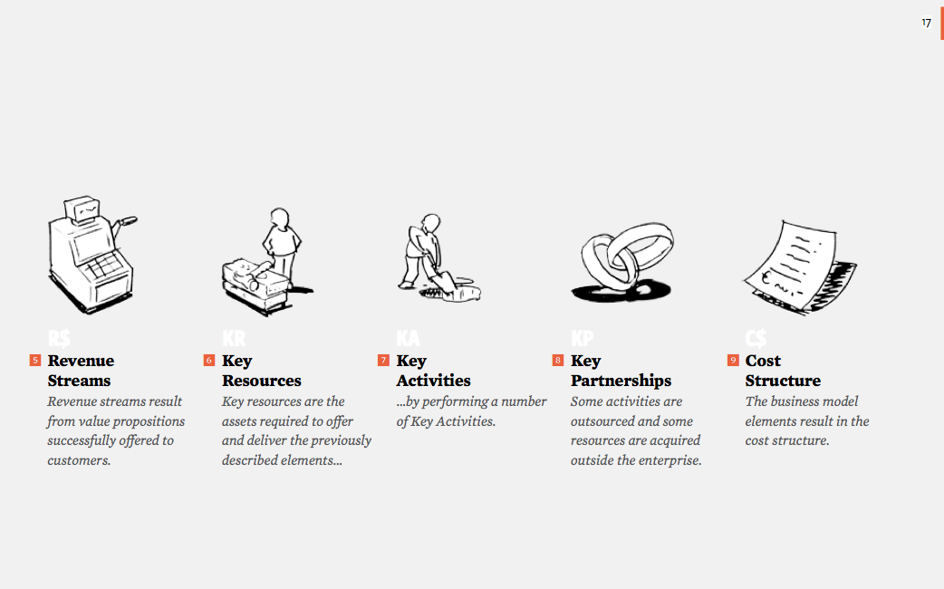
The Business Model Canvas (con’t)

